Slide 1
Transformers

Slide 2
Dot Product
Let's say we have two 3-dimensional vectors, A and B:
A = [1, 2, 3] B = [4, 5, 6]
A · B = (1 x 4) + (2 x 5) + (3 x 6) = 4 + 10 + 18 =32
Activity 1: Let's say we have two 2-dimensional vectors, A and B, represented as follows: A = [3, 5] B = [-2, 4], dot product of A and B ?
Activity2: Let's say we have two 4-dimensional vectors, A and B, represented as follows: A = [1, 2, 3, 4] B = [-4, 0, 2, 5], dot product of A and B?

Slide 3
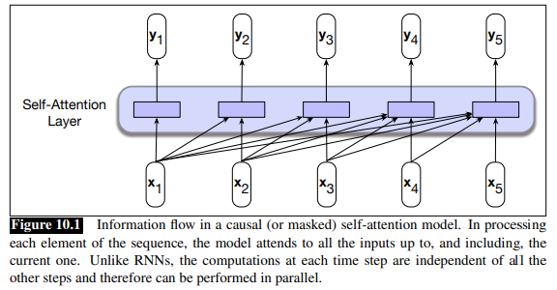
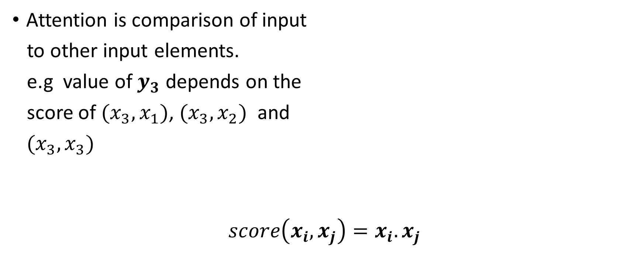
Self Attention
Attention is comparison of input
to other input elements.
e.g value of $y_{3}$ depends on the
score of $(x_{3},x_{1})$, $(x_{3},x_{2})$ and
${(x}_{3},x_{3})$
$$score\left(x_{i},x_{j}\right)=x_{i}.x_{j}$$
Notes:
The result of a dot product is a scalar value ranging from −∞ to ∞, the larger the value the more similar the vectors that are being compared. Continuing with our example, the first step in computing $y_{3}$ would be to compute three scores: $x_{3} · x_{1}$, $x_{3} · x_{2}$ and $x_{3} · x_{3}$.

Slide 4
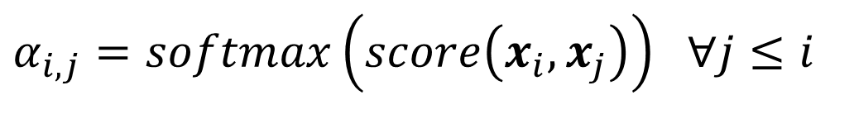

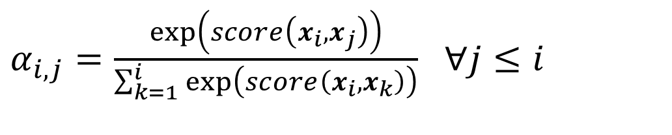
Self Attention
$α_{i,j}=softmax\left(score\left(x_{i},x_{j}\right)\right)$ $∀j≤i$
$α_{i,j}=\frac{\exp\left(score\left(x_{i},x_{j}\right)\right)}{\sum_{k=1}^{i}{\exp\left(score\left(x_{i},x_{k}\right)\right)}}$ $∀j≤i$
$$y_{i}=\sum_{j≤i}{α_{ij}x_{j}}$$
Notes:
Then to make effective use of these scores, we’ll normalize them with a softmax to create a vector of weights, $α_{i,j}$, that indicates the proportional relevance of each input to the input element $i$ that is the current focus of attention.
a set of comparisons to relevant items in some context, a normalization of those scores to provide a probability distribution, followed by a weighted sum using this distribution. The output y is the result of this straightforward computation over the inputs.

Slide 5
Activity

Slide 6












Query, Key, Value
Considering the output $y_{3}$
$$x_{3}$$
$$query$$
$$x_{1},x_{2},x_{3}$$
$$key$$
$$x_{1},x_{2},x_{3}$$
$$value$$
$$Attention Values$$
$$score\left(x_{3},x_{1}\right)=α_{31}$$
$$score\left(x_{3},x_{2}\right)=α_{32}$$
$$score\left(x_{3},x_{3}\right)=α_{33}$$
$${α_{31}x}_{1}+{α_{32}x}_{2}+α_{33}x_{3}=y_{3}$$
Notes:
• As the current focus of attention when being compared to all of the other preceding inputs. We’ll refer to this role as a query.
• In its role as a preceding input being compared to the current focus of attention. We’ll refer to this role as a key.
And finally, as a value used to compute the output for the current focus of attention.

Slide 7


Key, Query and Value Matrices
To capture the roles, transformer has 3 matrices
Transformer project each $x_{i}$ into query, key and value vectors
$$W^{Q},W^{K},W^{V}$$
$${q_{i}=W}^{Q}x_{i} ;{k_{i}=W}^{K}x_{i} :{v_{i}=W}^{V}x_{i}$$
$$W^{Q}{,W}^{K},W^{V}∈R^{d×d}, x_{i},y_{i}∈R^{1×d}$$

Slide 8
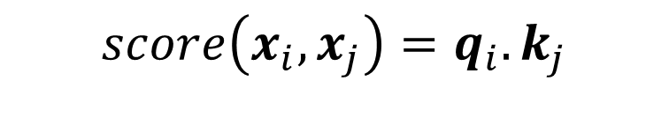
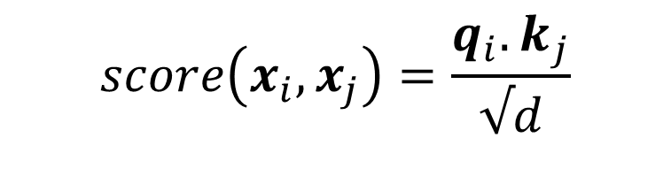

Self-attention (improved version)
$$score\left(x_{i},x_{j}\right)=\frac{{q_{i}.k}_{j}}{√d}$$
$$score\left(x_{i},x_{j}\right)=q_{i}.k_{j}$$
$α_{i,j}=\frac{\exp\left(score\left(x_{i},x_{j}\right)\right)}{\sum_{k=1}^{i}{\exp\left(score\left(x_{i},x_{k}\right)\right)}}$ $∀j≤i$
$$y_{i}=\sum_{j≤i}{α_{ij}v_{j}}$$
Notes:
The result of a dot product can be an arbitrarily large (positive or negative) value. Exponentiating such large values can lead to numerical issues and to an effective loss of gradients during training. To avoid this, the dot product needs to be scaled in a suitable fashion. A scaled dot-product approach divides the result of the dot product by a factor related to the size of the embeddings before passing them through the softmax. A typical approach is to divide the dot product by the square root of the dimensionality of the query and key vectors (dk), leading us to update our scoring function one more time, replacing Eq. 10.1 and Eq. 10.6 with Eq. 10.8:

Slide 9
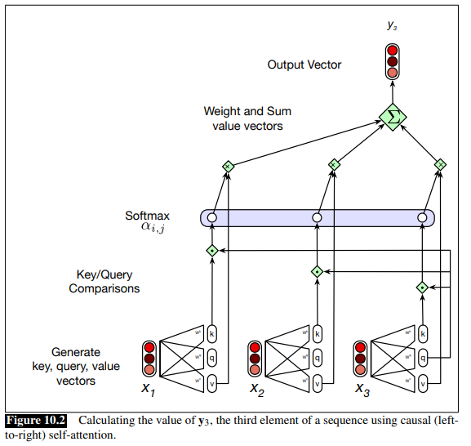

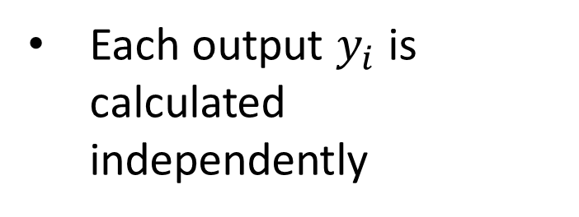
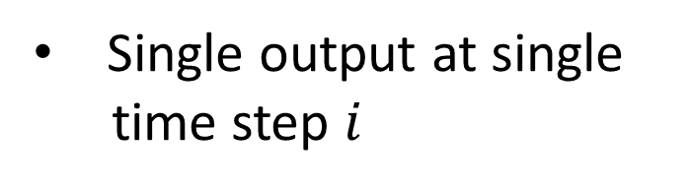
Visual look of calculating $y_{3}$
Single output at single
time step $i$
Each output $y_{i}$ is calculated independently

Slide 10
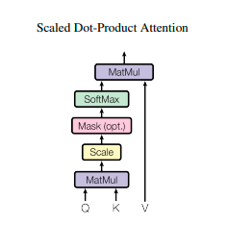


Vectorization
Input $X$: A sequence of $N$ tokens with embedding dimension $d$
$${Q=XW}^{Q} ;{K=XW}^{K} :{V=XW}^{V}$$
$$W^{Q}{,W}^{K},W^{V}∈R^{d×d}, X∈R^{n×d}$$
$$Q,K,V∈R^{n×d},$$
$$SelfAttention\left(Q,K,V\right)=softmax\left(\frac{{QK}^{T}}{√d}\right)V$$

Slide 11
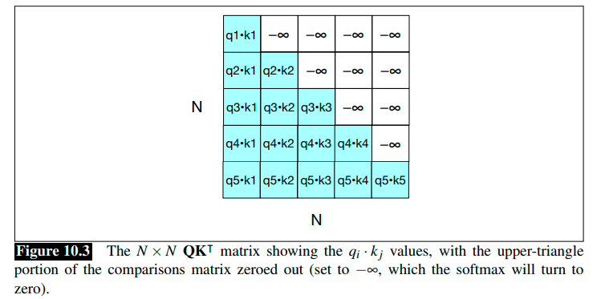
Attention Values
Attention is quadratic
In the length of input
Notes:
Fig. 10.3 also makes it clear that attention is quadratic in the length of the input, since at each layer we need to compute dot products between each pair of tokens in the input. This makes it extremely expensive for the input to a transformer to consist of long documents (like entire Wikipedia pages, or novels), and so most applications have to limit the input length, for example to at most a page or a paragraph of text at a time. Finding more efficient attention mechanisms is an ongoing research direction.

Slide 12
Residual Connection
In deep networks, residual connections are connections that pass information from a lower layer to a higher layer without going through the intermediate layer.
Residual connections in transformers are implemented by adding a layer’s input vector to its output vector before passing it forward.
$$x+SelfAttention\left(x\right),$$
Notes:
Residual connection Allowing information from the activation going forward and the gradient going backwards to skip a layer improves learning and gives higher level layers direct access to information from lower layers (He et al., 2016)

Slide 13

Residual Connection
Suppose we have an input matrix X representing word embeddings of a sentence:
X = [ [1, 2, 3],
[4, 5, 6],
[7, 8, 9] ]
Assume we have already calculated the SelfAttention(Q, K, V) matrix using the self-attention mechanism:
SelfAttention(Q, K, V) =
[ [0.5, 1.0, 1.5],
[2.0, 2.5, 3.0],
[3.5, 4.0, 4.5] ]
Residual_Connection =
X + SelfAttention(Q, K, V) =
[ [1.5, 3.0, 4.5],
[6.0, 7.5, 9.0],
[10.5, 12.0, 13.5] ]

Slide 14
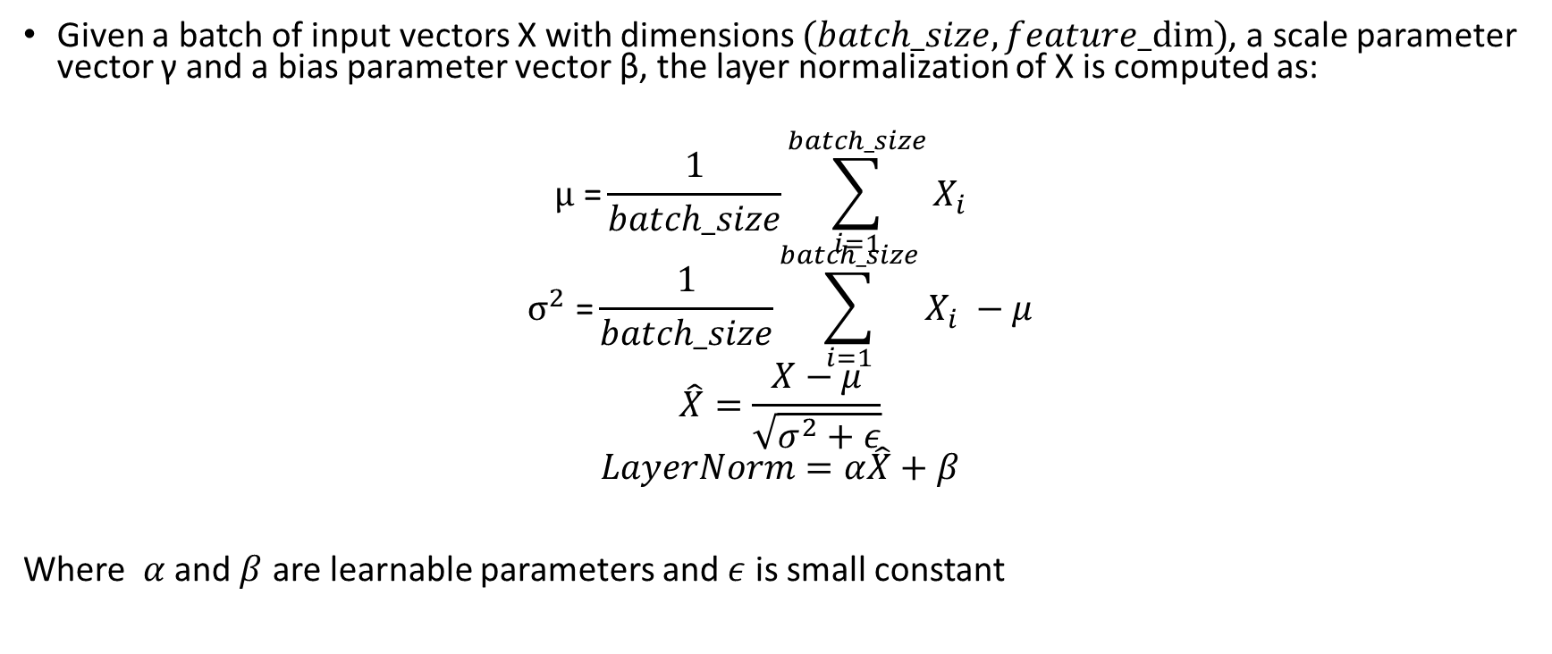
Layer Normalization
Given a batch of input vectors X with dimensions $(batch_size, feature_dim)$, a scale parameter vector γ and a bias parameter vector β, the layer normalization of X is computed as:
$$μ \text{=}\frac{1}{batch_size}\sum_{i=1}^{batch_size}{X_{i} }$$
$$σ^{2} \text{=}\frac{1}{batch_size}\sum_{i=1}^{batch_size}{X_{i} −μ}$$
$$\hat{X}=\frac{X−μ}{\sqrt{σ^{2}+ε}}$$
$$LayerNorm=α\hat{X}+β$$
Where $α$ and $β$ are learnable parameters and $ε$ is small constant
Notes:
Compute the mean and variance of X across the feature dimension: $\mu = \frac{1}{batch_size} \sum_{i=1}^{batch_size} X_i$ $\sigma^2 = \frac{1}{batch_size} \sum_{i=1}^{batch_size} (X_i - \mu)^2$
Normalize each input vector in the batch by subtracting the mean and dividing by the standard deviation (with a small constant ε added for numerical stability): $\hat{X}_i = \frac{X_i - \mu}{\sqrt{\sigma^2 + \epsilon}}$
Scale and shift the normalized input vectors by the learnable parameters γ and β, respectively: $Y_i = \gamma \hat{X}_i + \beta$
Stack the resulting normalized vectors to form the output tensor Y with the same shape as X: $Y = [Y_1, Y_2, ..., Y_{batch_size}]$
Here, the subscripts i and j denote the i-th example in the batch and the j-th feature in the input vector, respectively.
Note that the above steps assume that the normalization is performed along the feature dimension (i.e., the last dimension of the input tensor), which is the most common use case for layer normalization. If you want to normalize along a different dimension, you can simply adapt the equations accordingly.
Regenerate response

Slide 15
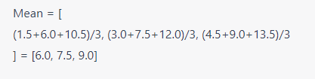
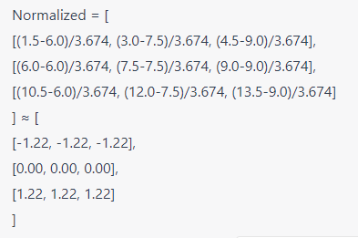
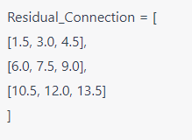
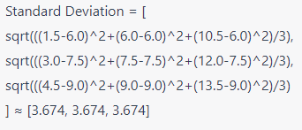
Layer normalization
Step 1: Calculate the mean and standard deviation of each feature.
Step 2: Normalize each feature using the mean and standard deviation
Notes:
It helps in stabilizing the training process and reducing the training time. Layer normalization computes the mean and standard deviation for each feature across all data points in a layer and normalizes the features using these statistics. Here's a step-by-step example using the Residual_Connection matrix from the previous context:

Slide 16
Layer normalization
Step 3: Apply learnable scale and shift parameters
Layer normalization also includes learnable parameters (gamma) for scaling and (beta) for shifting. For simplicity, assume gamma = 1 and beta = 0.
Layer_Normalized = gamma * Normalized + beta ≈
[ [-1.22, -1.22, -1.22],
[0.00, 0.00, 0.00],
[1.22, 1.22, 1.22] ]
Notes:
It helps in stabilizing the training process and reducing the training time. Layer normalization computes the mean and standard deviation for each feature across all data points in a layer and normalizes the features using these statistics. Here's a step-by-step example using the Residual_Connection matrix from the previous context:

Slide 17
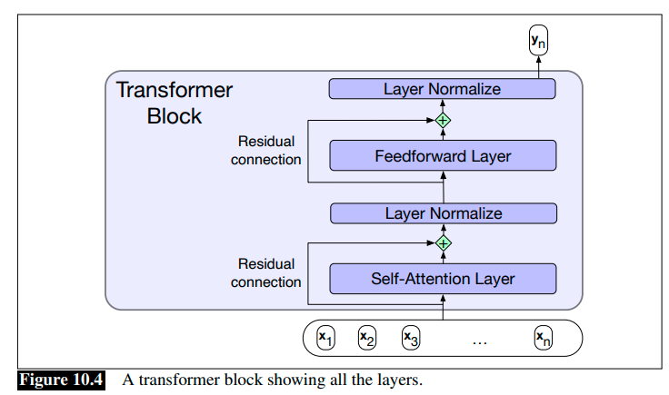
Transformer Block
Notes:
The self-attention calculation lies at the core of what’s called a transformer block, which, in addition to the self-attention layer, includes additional feedforward layers, residual connections, and normalizing layers. The input and output dimensions of these blocks are matched so they can be stacked just as was the case for stacked RNNs.
Fig. 10.4 illustrates a standard transformer block consisting of a single attention layer followed by a fully-connected feedforward layer with residual connections and layer normalizations following each.

Slide 18
MultiHead Attention
MultiheadAttention$\left(X\right)=\left(head_{1}⊕head_{2}⊕…head_{h} \right)W^{O}$
$$Q={XW}_{i}^{Q} : K={XW}_{i}^{K} : V={XW}_{i}^{V}$$
$$head_{i}=SelfAttention\left(Q,K,V\right)$$
$$W^{Q}∈R^{d×d_{k}}{,W}^{K}∈R^{d×d_{k}},W^{V}∈R^{d×d_{v}}, X∈R^{n×d}$$
$$Q∈R^{N×d_{k}},K∈R^{N×d_{k}},V∈R^{N×d_{v}},$$
$$W^{O}∈R^{hd_{v}×h}$$
Notes:
The different words in a sentence can relate to each other in many different ways simultaneously. For example, distinct syntactic, semantic, and discourse relationships can hold between verbs and their arguments in a sentence. It would be difficult for a single transformer block to learn to capture all of the different kinds of parallel relations among its inputs. Transformers address this issue with multihead selfattention layers. These are sets of self-attention layers, called heads, that reside in multihead self-attention layers parallel layers at the same depth in a model, each with its own set of parameters. Given these distinct sets of parameters, each head can learn different aspects of the relationships that exist among inputs at the same level of abstraction.

Slide 19
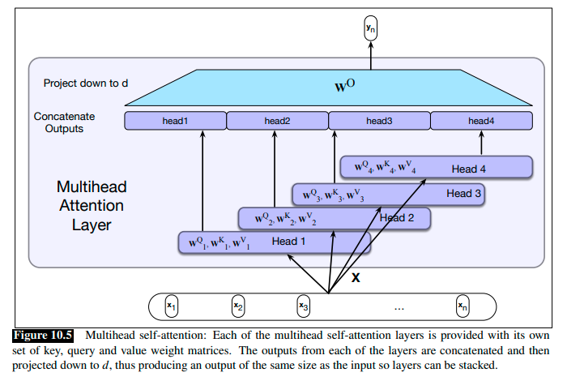
Multihead Attention

Slide 20
Multihead Attention Transformer Block
Multihead Attention

Slide 21
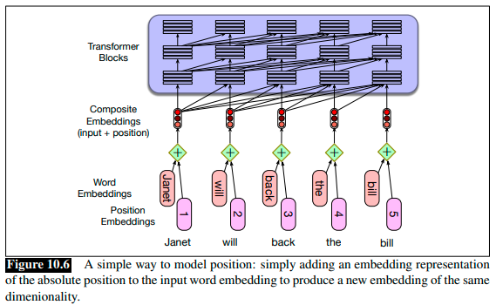
Word Order
Does transformer model the position of each token in the input sequence ?
Notes:
The basic idea behind positional embedding is to add information about the position of words or tokens in a sequence to the embedding vectors, which represent the meaning of the words. The position information is added through a learned function that maps the position of each token in the sequence to a fixed-length vector representation, which is then added to the corresponding word embedding vector.
The reason for using positional embedding is that the order of words in a sequence is important for understanding the meaning of the text, and simple word embedding vectors do not capture the order information. By adding positional information to the word embeddings, the model can better understand the relationships between the words in a sequence.
There are different ways to compute positional embeddings, but one common method is to use a fixed mathematical function such as sine and cosine functions that can generate a unique embedding for each position in the sequence. The resulting positional embeddings are then added to the corresponding word embeddings before being fed into the transformer-based model.

Slide 22
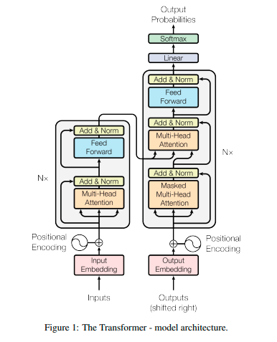
Transformer architecture

Slide 23
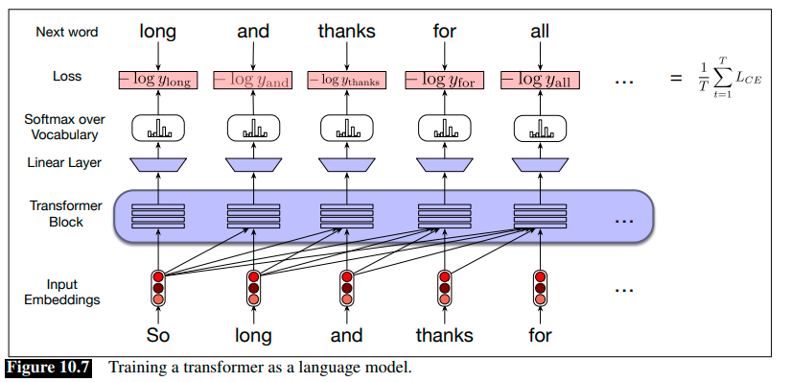



Transformers as Language Model
$$L_{CE}\left({\hat{y}}_{t},y_{t}\right)=−\log{{\hat{y}}_{t}[w_{t+1}]}$$
Where $w_{t+1}$is the correct next word in the input sequence
Teacher forcing
Notes:
Fig. 10.7 illustrates the general training approach. At each step, given all the preceding words, the final transformer layer produces an output distribution over the entire vocabulary. During training, the probability assigned to the correct word is used to calculate the cross-entropy loss for each item in the sequence. As with RNNs, the loss for a training sequence is the average cross-entropy loss over the entire sequence.

Slide 24
Generating a text from Language model
Once language model trained we generate the text in the following way
Sample a word in the output from the softmax distribution that results from using the beginning of sentence marker, <s>, as the first input.
Use the word embedding for that first word as the input to the network at the next time step, and then sample the next word in the same fashion.
Continue generating until the end of sentence marker, </s>, is sampled or a fixed length limit is reached.
$\hat{y_{t}}=argmax_{w∈V}P\left(w | y_{1}y_{2}…y_{t−1}\right)$ greedy decoding

Slide 25
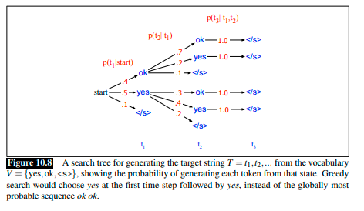

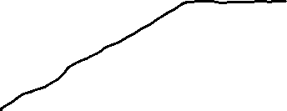
Greedy approach problem
Objective: Target string with highest probability
Greedy approach: "yes yes </s>” not highest probable

Slide 26
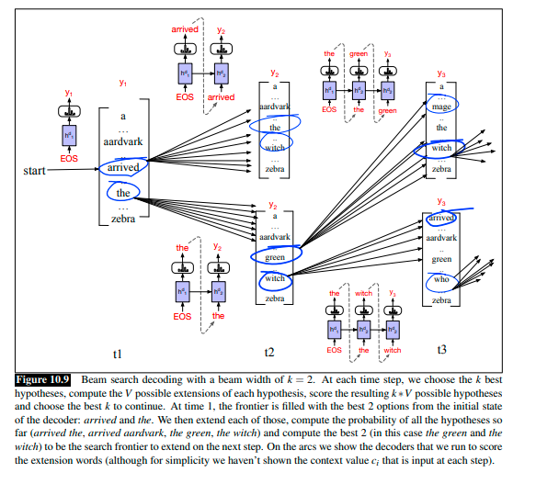

Beam Search
Beam width$k=2$
Hypotheses

Slide 27

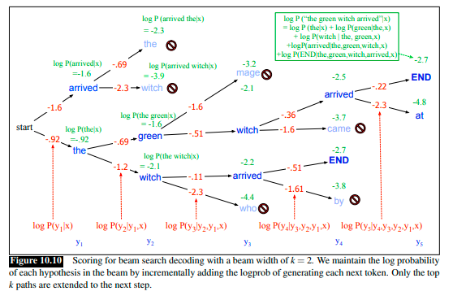
Calculating probabilities

